Slide 1

Day 3 – 11:30
Project Progress Report
-Tympe-
Logan Schlick, Daniel Marin, Kyle Rimando, Sonny Pizzo, Shane Ghuste

Slide 2


Front end progress…
Completed game’s start page
Working on the game page
Make it look more organized and clean
Front end designers:
  Daniel Marin
  Sonny Pizzo

Slide 3

Back end progress…
Fixed linkage of score to game
Gave words point value based off size
Timer issues
Back end designers:
  Logan Schlick
  Kyle Rimando

Slide 4

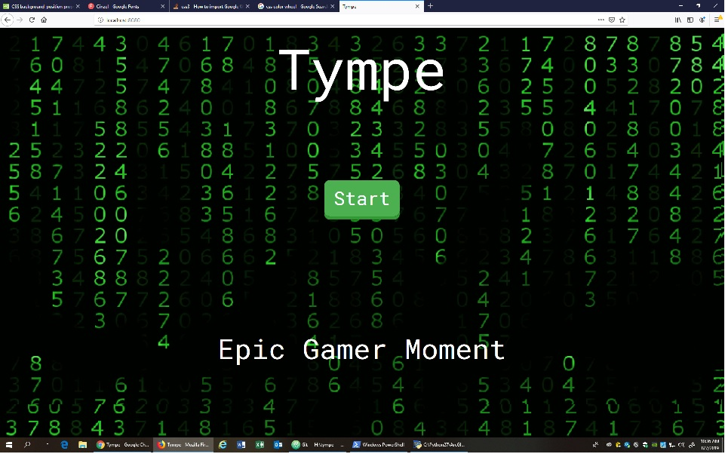
Start page
Game page

